Slide 1
INFO 7390 Assignment 2 Lending Club Dataset
By - TEAM 03 Sonali Chaudhari Madhumathi Prakash
Professor - Sri Krishnamurthy

Slide 2
Problem Statement
You are working at a bank and you are considering investing in Lending club. Since there are no standard models, you are expected to build prediction models that will help you predict the interest rates based on various parameters users would input.

Slide 3
Part 1 : Data Scraping, missing data, EDA, Feature selection, Luigi

Slide 4
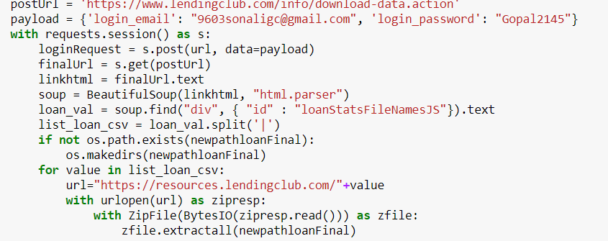
Scraping Data from lending Club

Slide 5
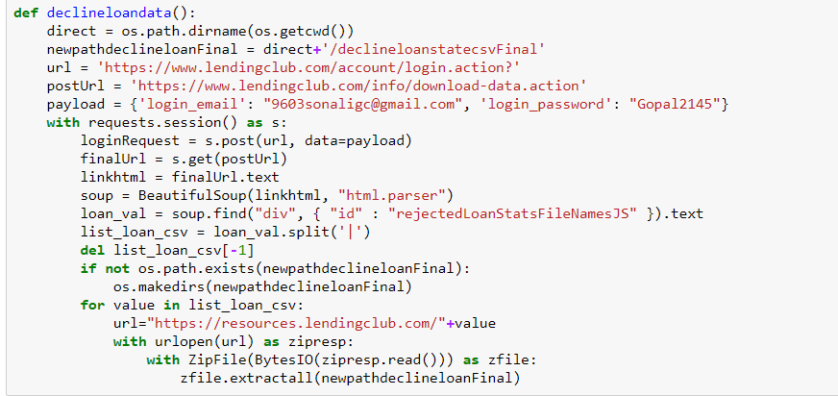
RejectedState from lending Club
We used beautiful soap to find the hidden class with id of loanStatsFileNameJS and same thing but with rejectedStateFileNameJS.

Slide 6
Data Preprocessing: Loan Data –part 1
Steps:
Loaded each programmatically downloaded CSVs in separate dataframe.
Concatenated each dataframe in a single dataframe ‘loan_data’.
Going through each column and understanding the meaning of each column through the dictionary provided on the LC website ‘LCDataDictionary.xlsx’
Getting rid of the columns have more than 70% missing data. During this process we get rid of the column ‘id’ which has all rows null.
Out of the 151 columns most of the columns are generated after the loans application procedure has taken place. So these columns leak data from the future. We need columns data that potential customer provided to LC during their application.

Slide 7
Part 2
Created a list ‘f’ a features that are important for and received during initial borrower’s application.
Created a dataframe ‘df’ consisting of all the features in the list ‘f’ and generated a column ‘id’ for uniquely identifying each entry.
Retrieved the count of nulls in each column in ‘df’ to deal with missing data in every
Getting rid of the row having most of the columns null.
Getting the dataframe to have consistent formats for each column entry and logically

Slide 8
Part 3
Replacing the NaN values for some categorial columns
The columns like emp_length, int_rates, zipcode, dti… are of type object and has no consistent format
Replaced dti_joint, annual_inc_joint null values to ‘0’ for the application_type ‘Individual’ since those application has no co-borrower and hence dti_joint, annual_inc_joint becomes 0.
Filled the remaining null values for annual_inc with the mode annual_inc value in a particular sub_grade column that the row belongs to.
Similarly for dti_joint column
There are columns ‘fico_range_high’ and ‘fico_range_low’; so generated a new column ‘fico_avg’ having the average of both the column values
Change the datatype of necessary columns and adding new column approval having
Similarly we handed decline data

Slide 9
EDA:
We performed exploratory data analysis the loan data and decline data separately and few EDAs for combine data.

Slide 10
Part 2

Slide 11
Classification- Models Implemented
We implement Logistic regression, Random Forest, Neural Network models algorithms.

Slide 12
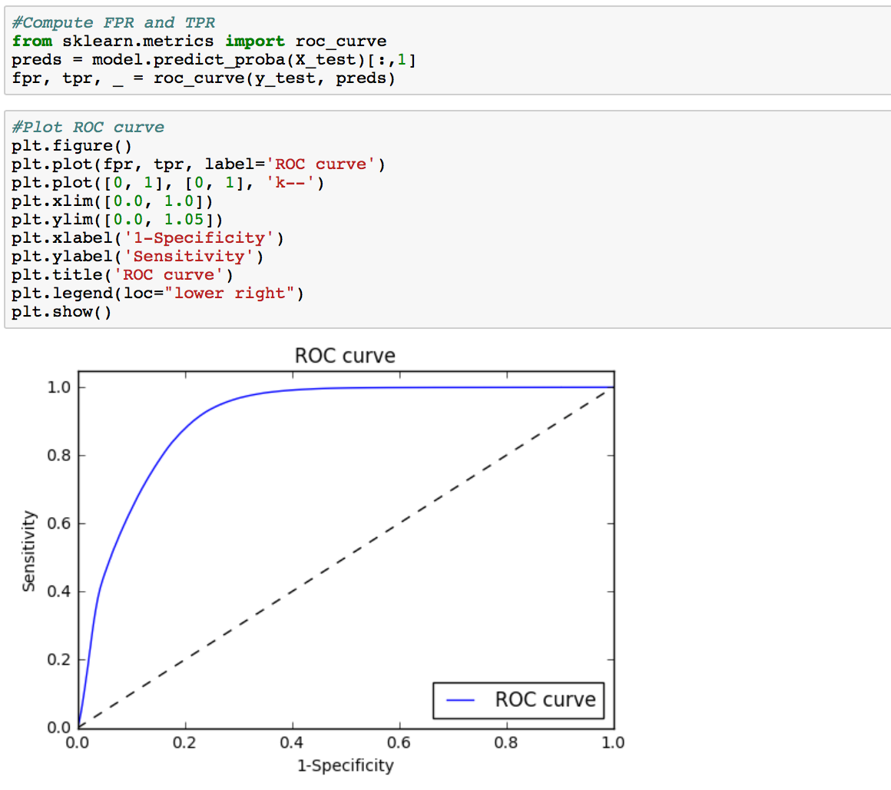
Logistic Regression

Slide 13
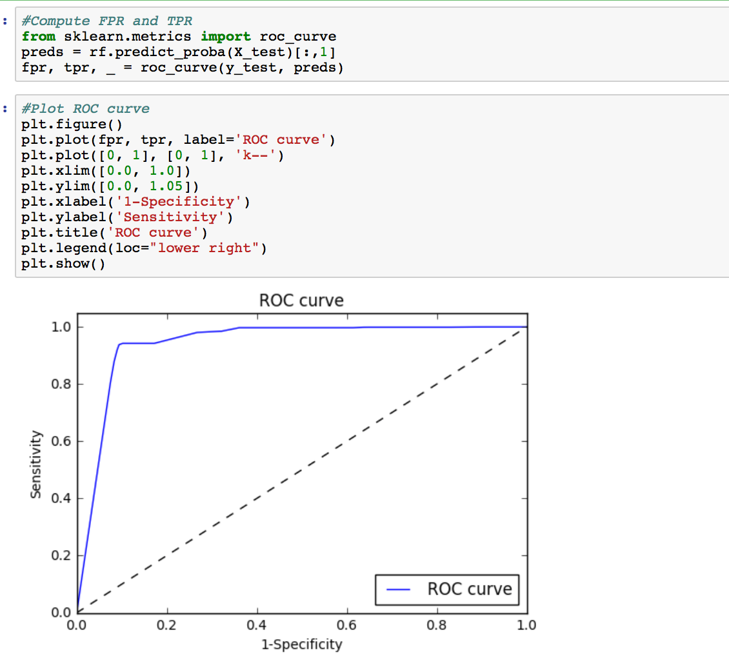
Random Forest

Slide 14
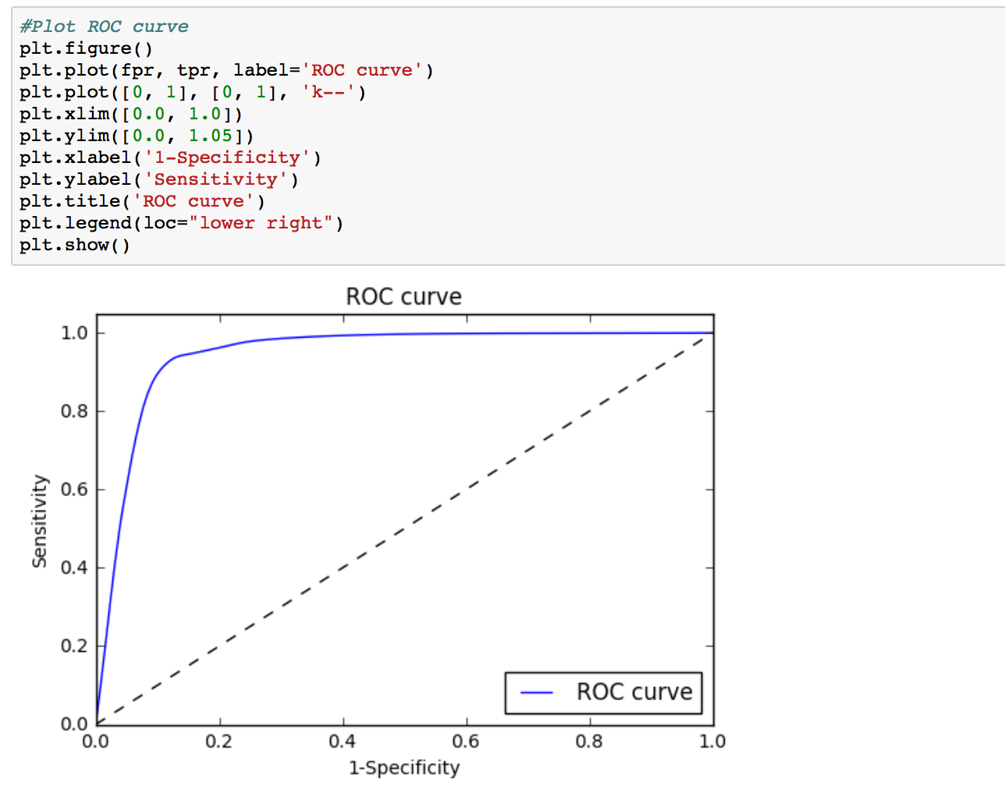
Neural Network

Slide 15
Clustering: No Cluster
We just used the feature selected docs for this.

Slide 16
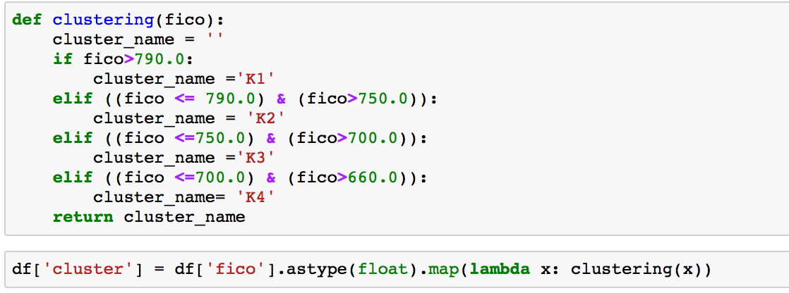
Manual Clustering

Slide 17
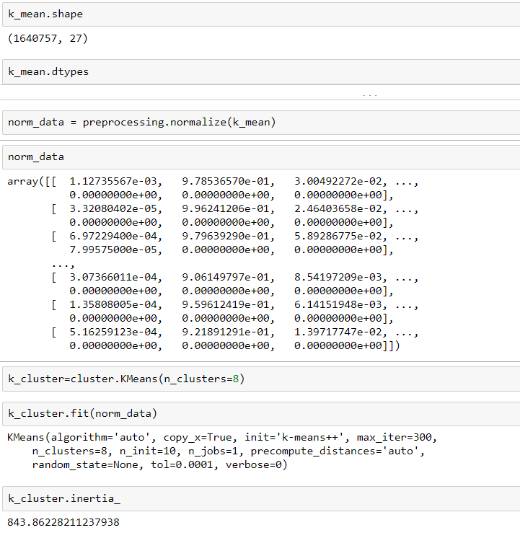
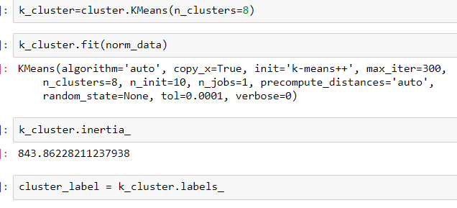
K- Means Clustering

Slide 18
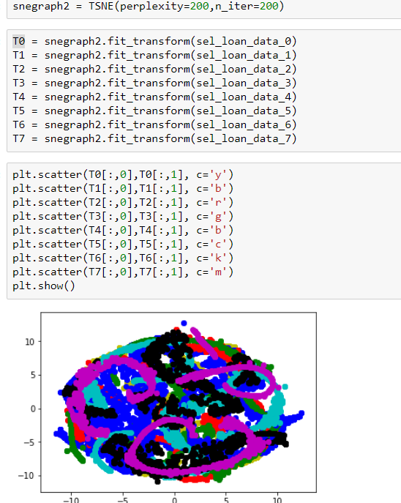
T-sne

Slide 19
Prediction
We have a file that is created for regression and in that we have run all 13 clusters.
So a model for no cluster with below result:

Slide 20
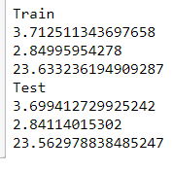
No Cluster

Slide 21
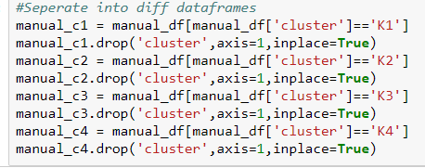
Manual Cluster

Slide 22
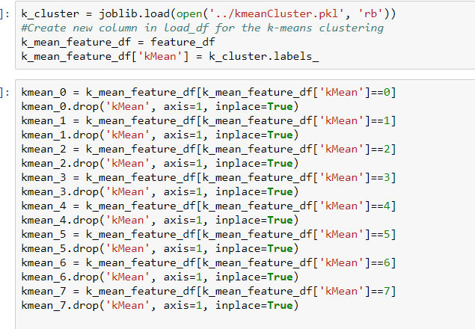
K-Means Cluster

Slide 23
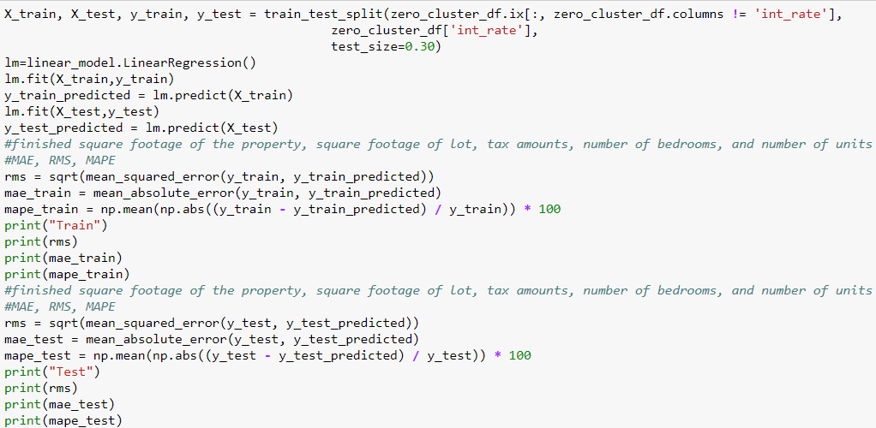
Regression

Slide 24
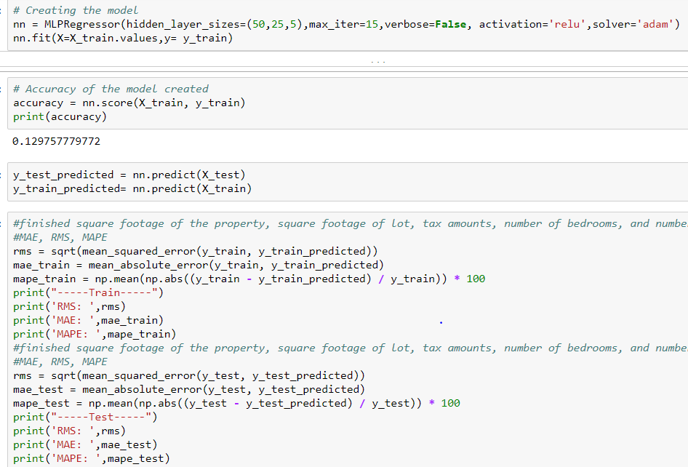
Neural Network

Slide 25
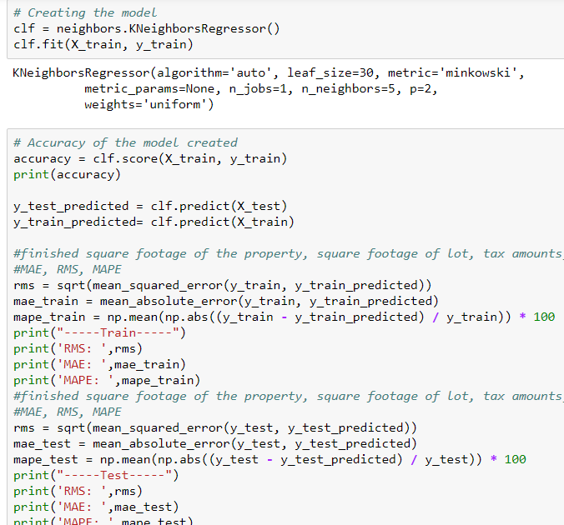
KNN

Slide 26
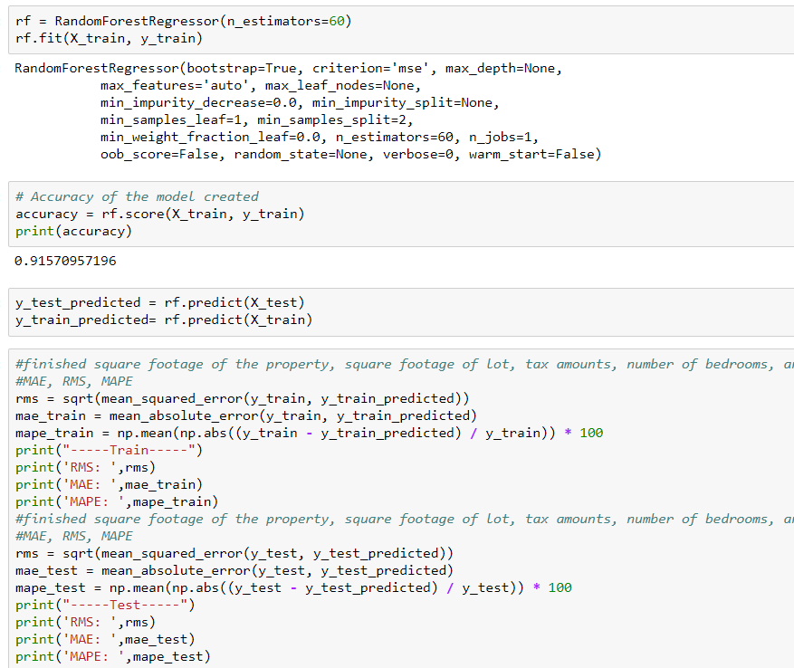
Random Forest

Slide 27
DEPLOYMENT
We did all the deployment in Microsoft Azur
We have selected RANDOM FOREST to deploy as the best model for all 13 clusters (1 0-cluster, 4 manual clusters, and 8 K-means cluster)

Slide 28
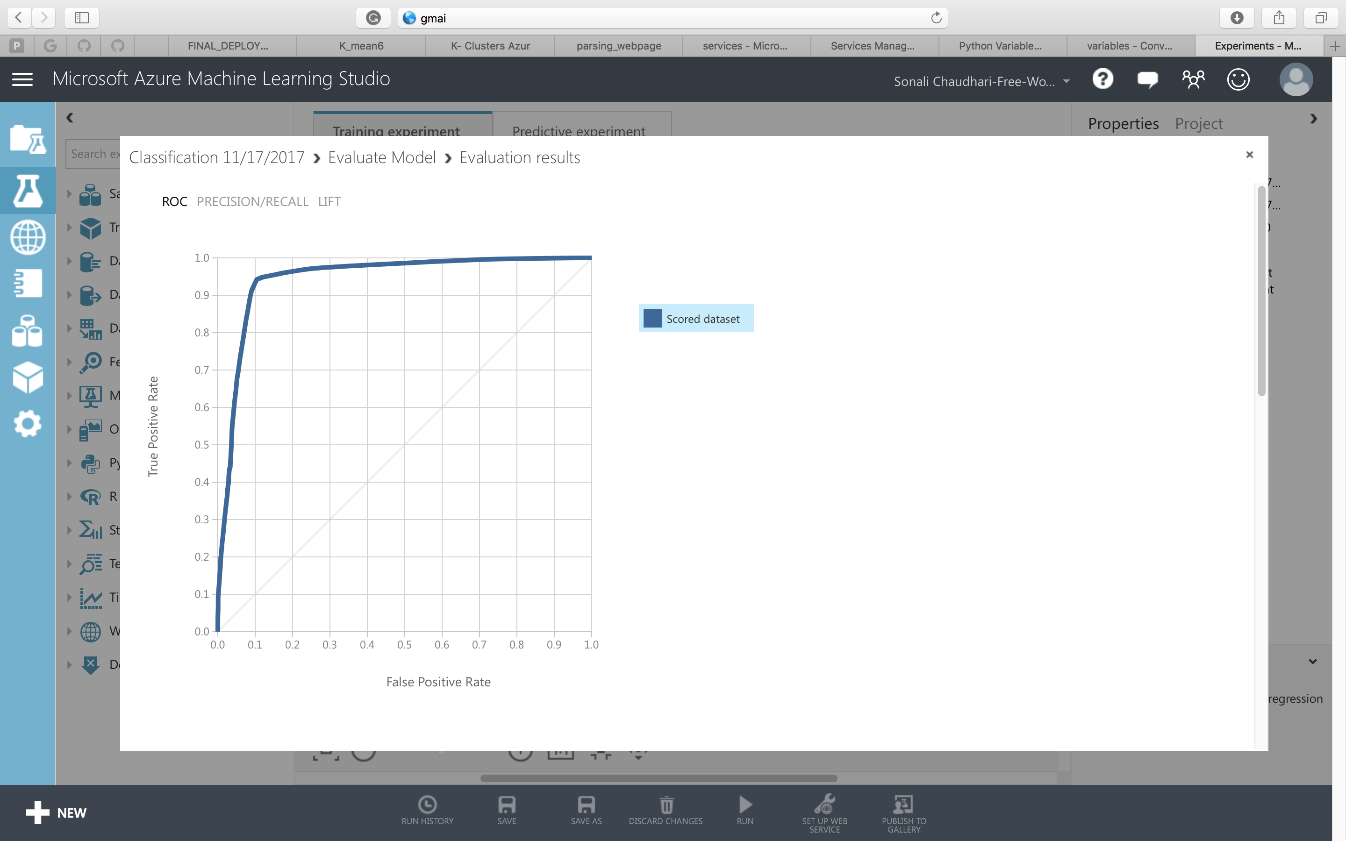
Classification Deployment Random Forest

Slide 29
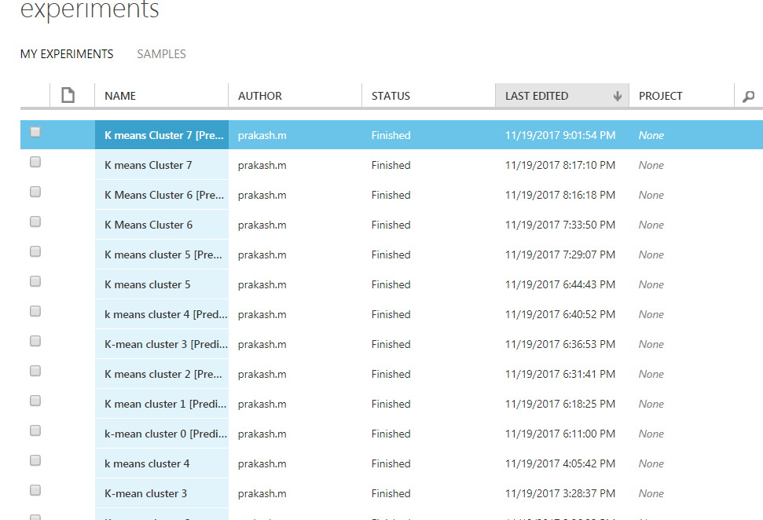
Experiments

Slide 30
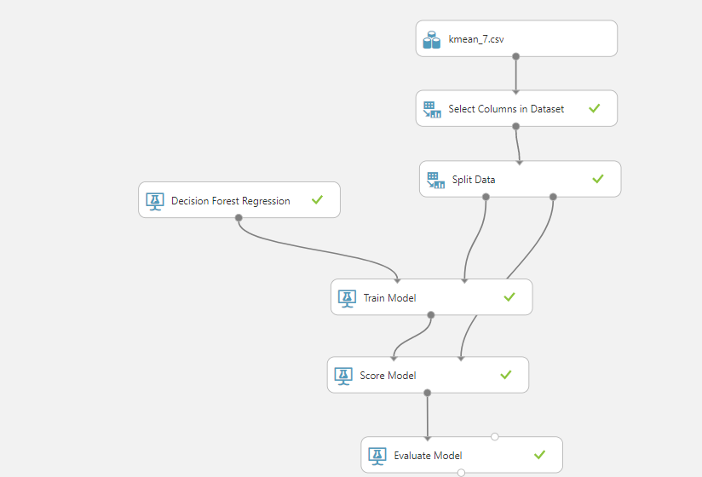
Cluster Prediction Models

Slide 31
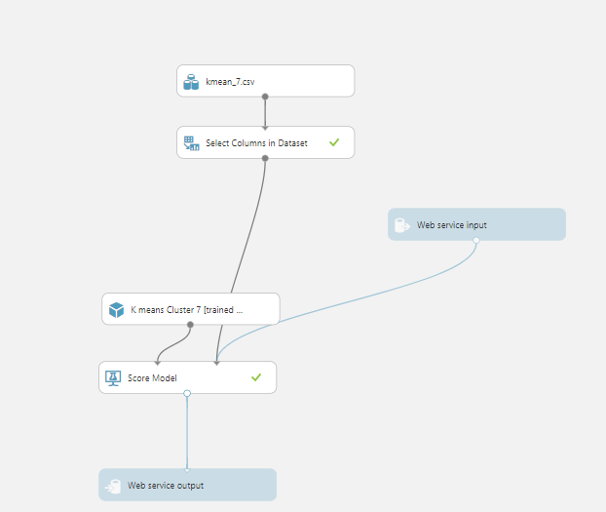
Set-up Web service
We then setup web service. In this step we change the “selected column” and take out the interest rate as we are calculating that, and any other columns that we do not want

Slide 32
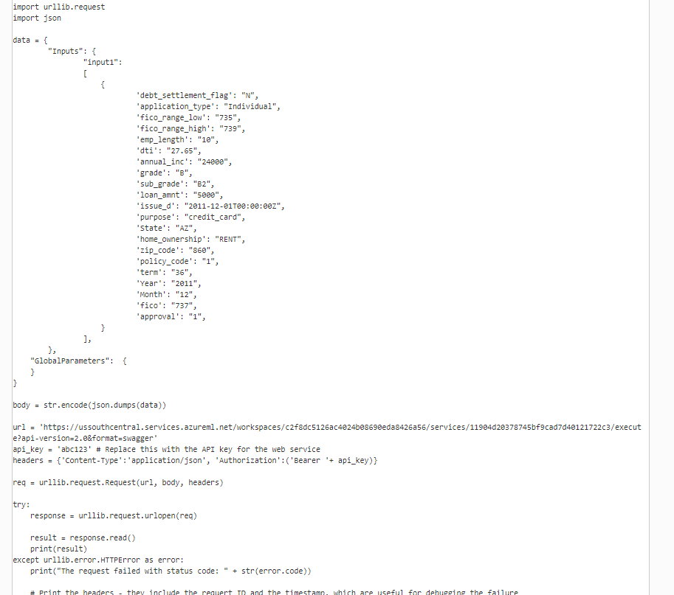
Deployed API
After that we deploy and get API and we go to “Test” and go to config to get python 3+ code. We have 13 AIP and below we can see the code for python.

Slide 33
Final Deployment Testing
There are bunch of input values a user has to give like
Loan Amount
Income
Debt to Income Ratio
Zipcode
State
Year
Month
Length of Employment
No Cluster: First we pass these parameters and pass to the No Cluster deployment code inputs and get the predicted interest rate after parsing the result and store it in ‘rate1’
Manual Cluster: Then we check for the fico score the user entered and get the cluster which it belongs to. The we pass those inputs to those cluster deployment code and get the interest rate predicted and store it on ‘rate2’.
K-Means: We pass the input parameters to all the 8 clusters we have and get the interest rates predicted for each cluster. We get the max of all the resulted predicted interest rates for K-Means clusters and store it in ‘rate3’.
Finally we have 3 interest rates predicted for our 3 clustering methods.
We get the best interest rate by taking the max of the rate1, rate2, rate3.

Slide 34
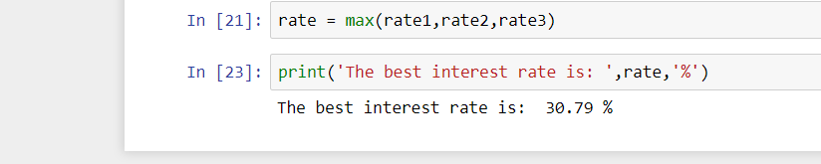
Result

Slide 35
Analysis
While looking at the data we realized that there were 157 columns. We have removed everything about 70% missing. When analyzing this data, we realized that there in decline data, there was a lot of risk score data missing. There was no point of filling in the data as it has no basis of what to fill it o since there was only 9 columns and second we will change the data a lot if we do so. We therefore took a look at the data and removed 1/3rd of the decline data on that basis.
Also in loan data we realized a fico score below 660 is not correct as it was mentioned in the lending club site. A person must have at least that to get a loan. Also, anything below 330 in decline for risk score was removed, since someone cannot have that as a possible fico score.
We have also looked at the relationships between the columns to input the data using knn like annual income and interest rate. Also, there were 2 states when looking into the site that would have to be removed since lending club is illegal there.
Looking at accuracy between classification and prediction, we can see that classification is much better. This would be mostly be because there is a strong distinction as to what kind of data combination will cause someone to get interest rate or not. Also lending club probably only really uses these 9 columns to determine whether to give a loan or not. However, prediction gives an interest rate and we are only considering a certain number of fields. In real life though lending club would be taking into consideration way more than what we did.

